Slide 1

ARENA Casino Portal
Subhash Gumpena
Yaswanth Kurre

Slide 2
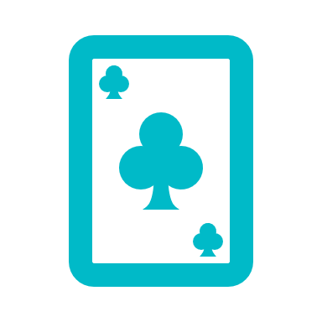
Motivation
Online casino projects are a great way to learn about web development, user experience design, and game design. They can also be a lot of fun to create and play.
Challenge yourself to build a complex and engaging web application, while learning about game design and user experience.
Building an online casino project, you'll be able to create a real-world web application with users and revenue potential.

Slide 3
Project Flow
Casino
Casino
User
All Games
Wanna play a Game?
Login
All Games
Join Now

Slide 4
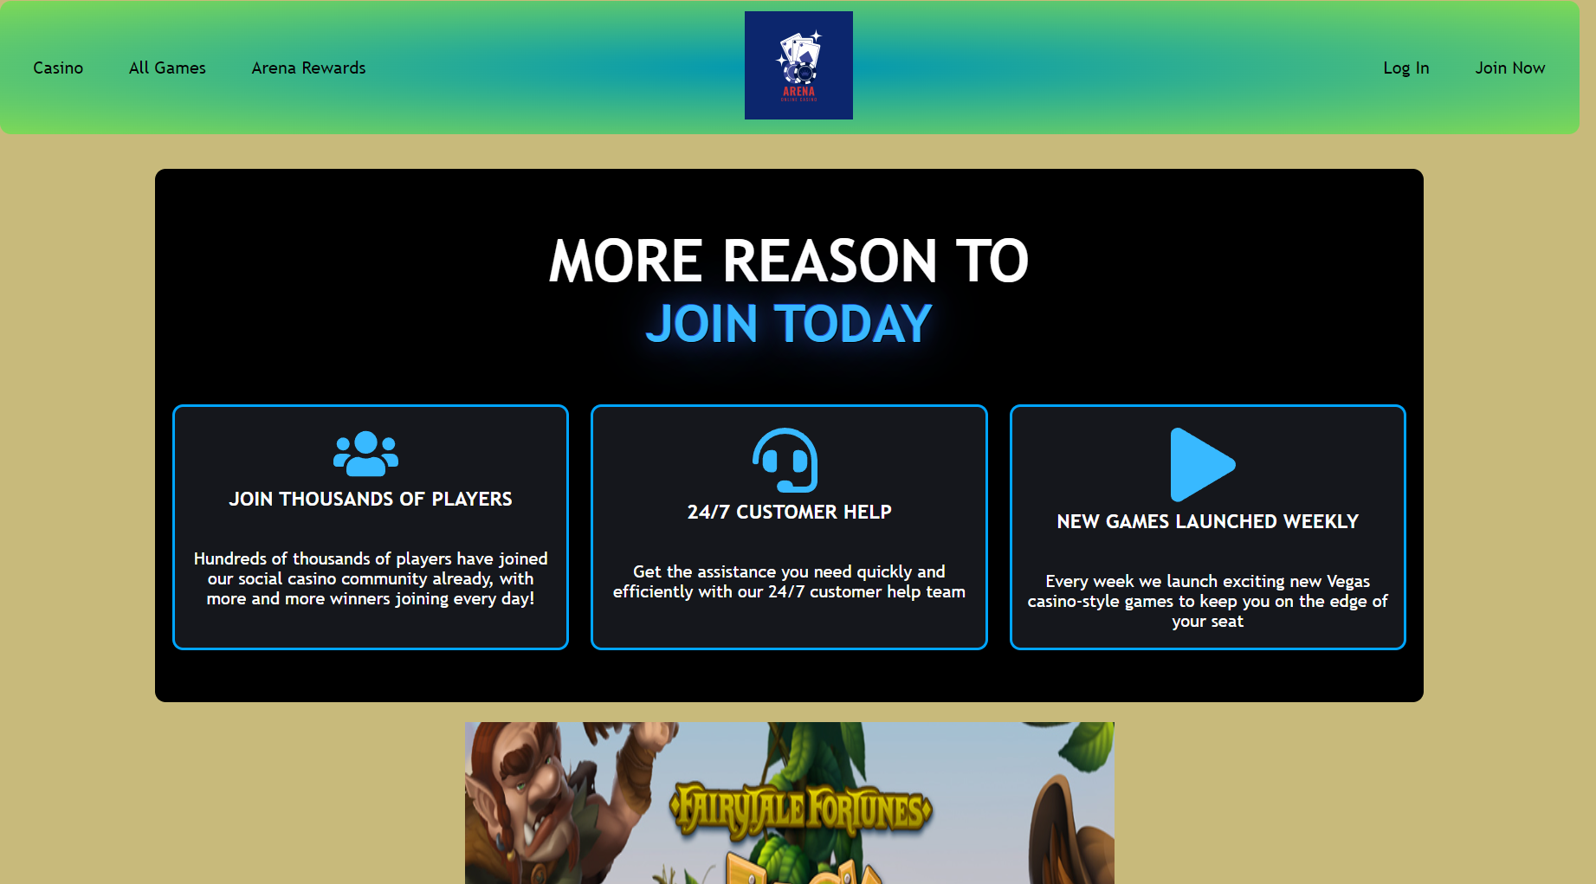
Home Page and Menu Items
Casino menu action in the top is the homepage of the portal.
All Games menu will be taking you to available games to play.
Login is a popup window to let you access your account.
Join now is a Signup page to create your account.

Slide 5
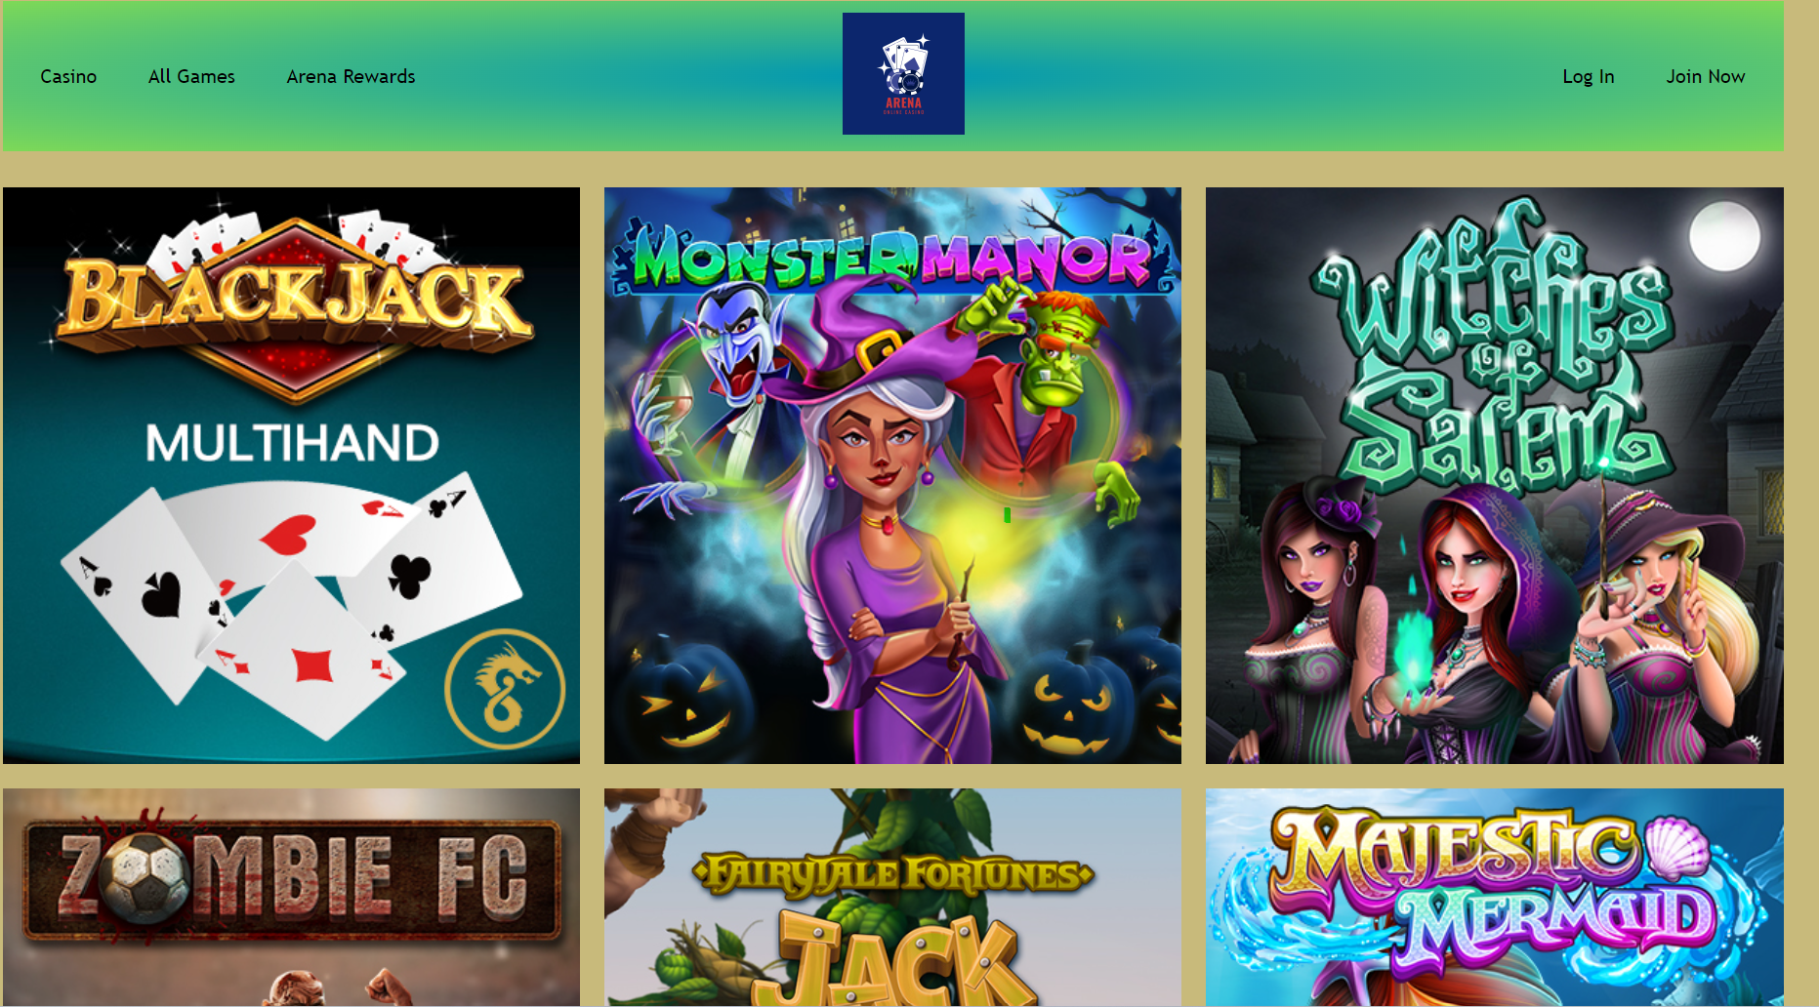
All Games Page
Lists all the available online games.
Hover on each game to get play now button.
When hover the game cover will be faded out and a play now button shows up.

Slide 6
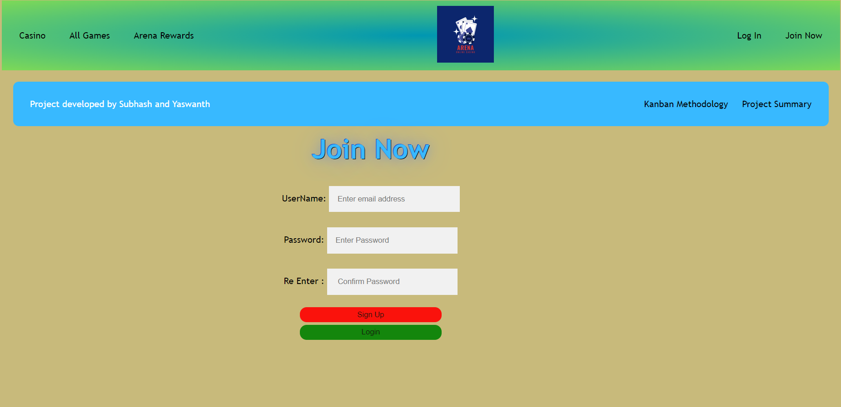
Join Now Page
Allows the users to create a new account in our gaming portal.
If account exists, they can directly login from this page as well.
NOTE: We don’t have any database implemented to create and store user details though.

Slide 7
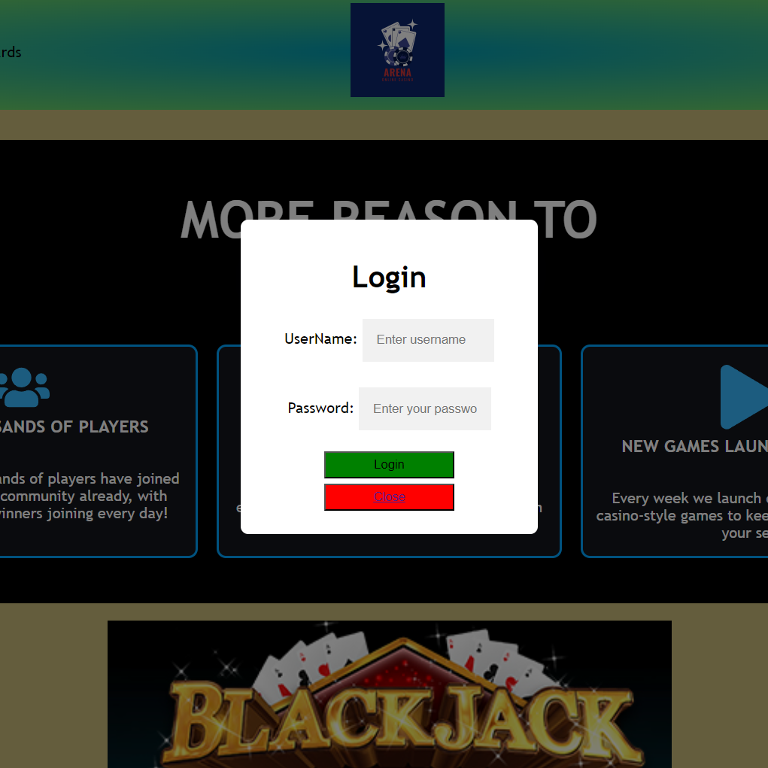
Log In Popup
Allows the users to login to their account in our gaming portal.
If account does not exist, they can create new account by clicking on Join Now menu action.
NOTE: We don’t have any database implemented to create and store user details though.

Slide 8
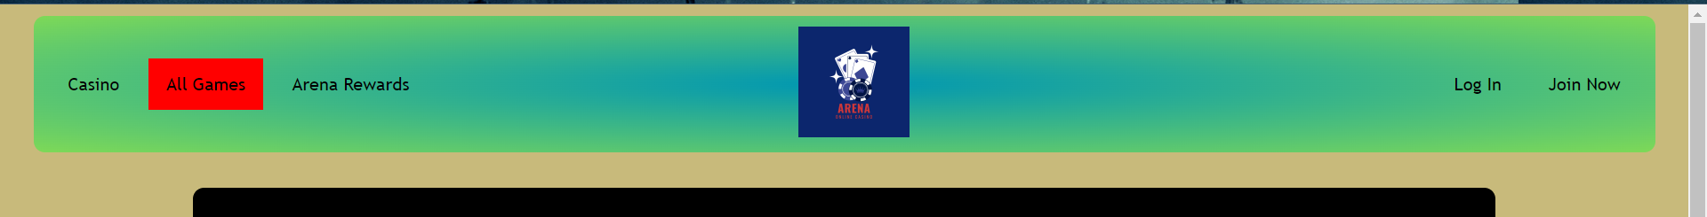
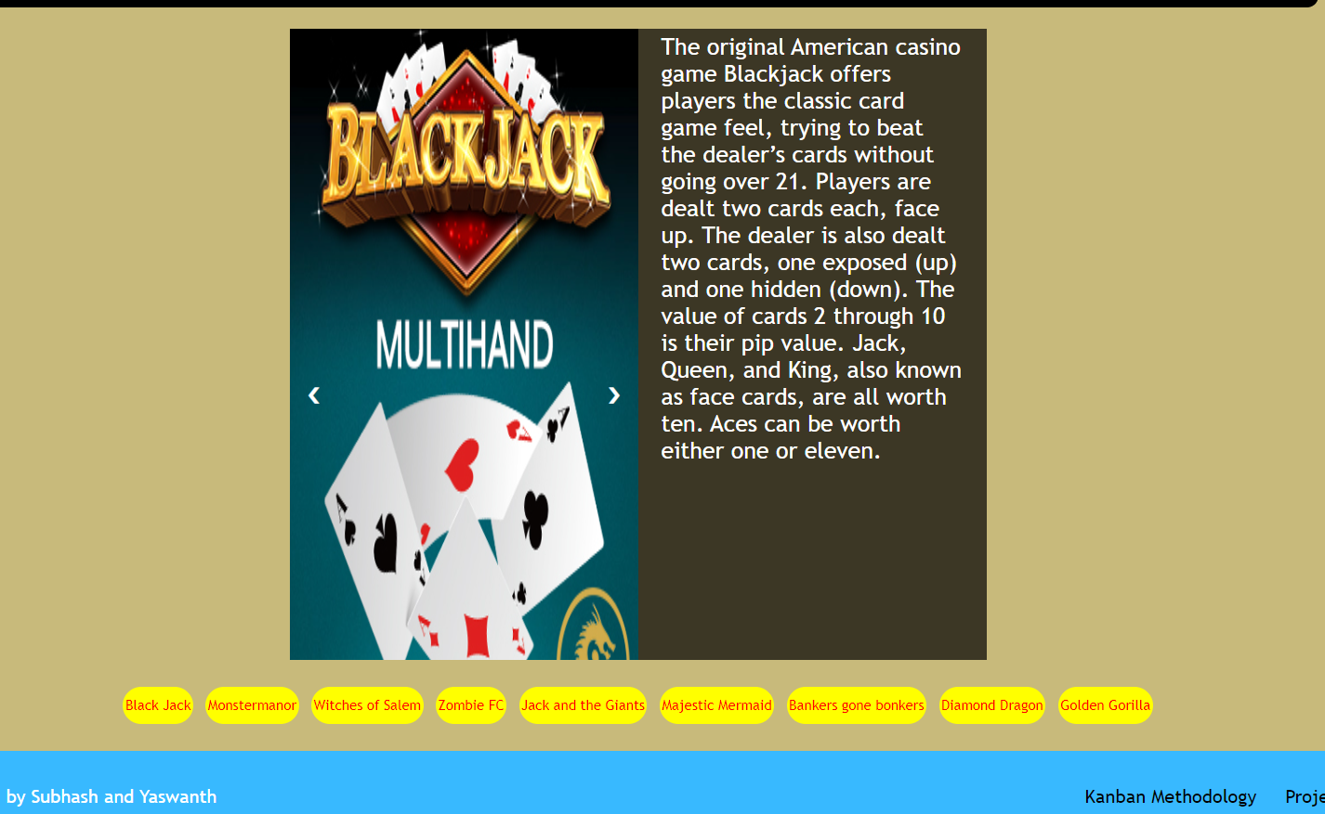
Features
When hover on a menu item it will be highlighted as shown in pic1
When hover on a game, this will display the information about the game
Click on the buttons below to navigate to the game you needed.

Slide 9
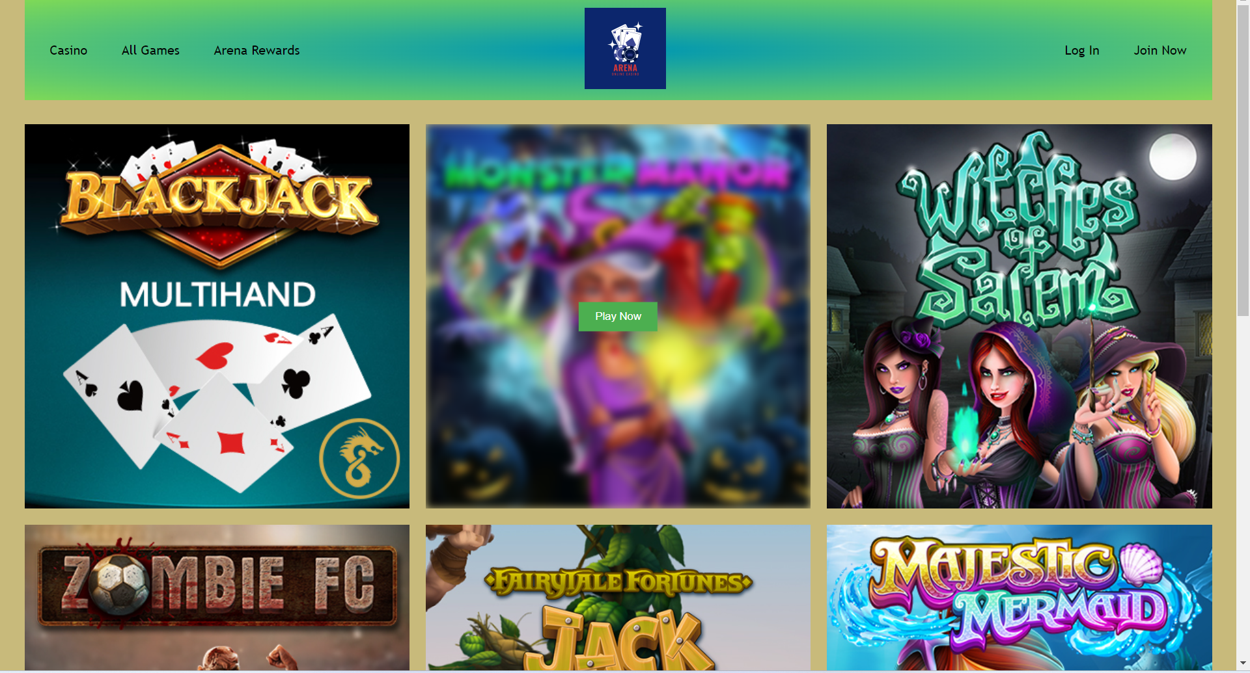
Features
When hover on a game, a pop up will be showed as Play Now to play the game.

Slide 10
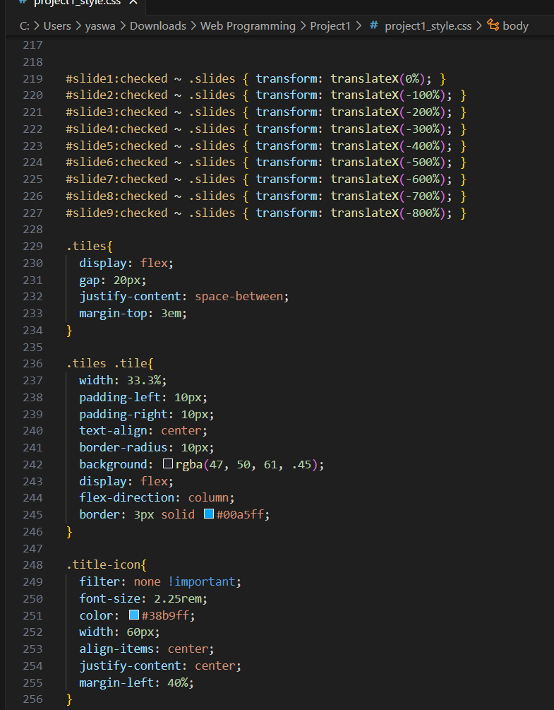
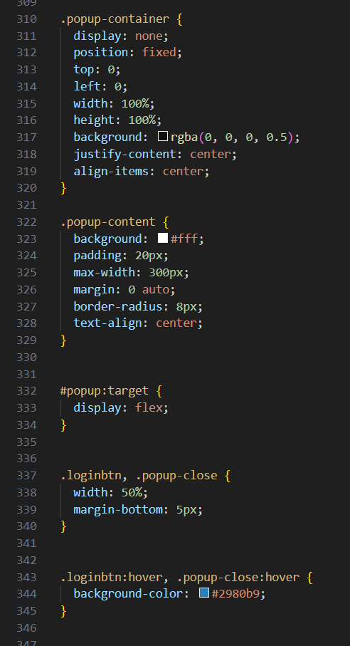
Sample CSS Code Snippets

Slide 11

Thank you

